Slide 1
GUVI Capstone Crafting Compelling Web Presences – MBM6
BY AZOR SOLOMON L S

Slide 2

SAMSUNG

Slide 3
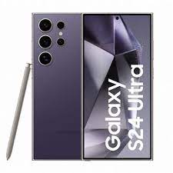
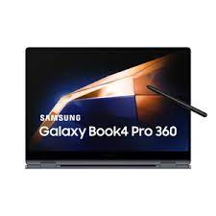
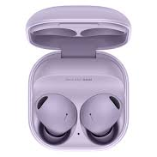
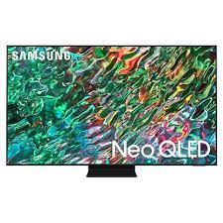
Products We are going to Cover
Galaxy Book4 Pro
Galaxy Buds2 Pro
Galaxy S24 Ultra
4K Ultra HD Smart Neo QLED TV

Slide 4
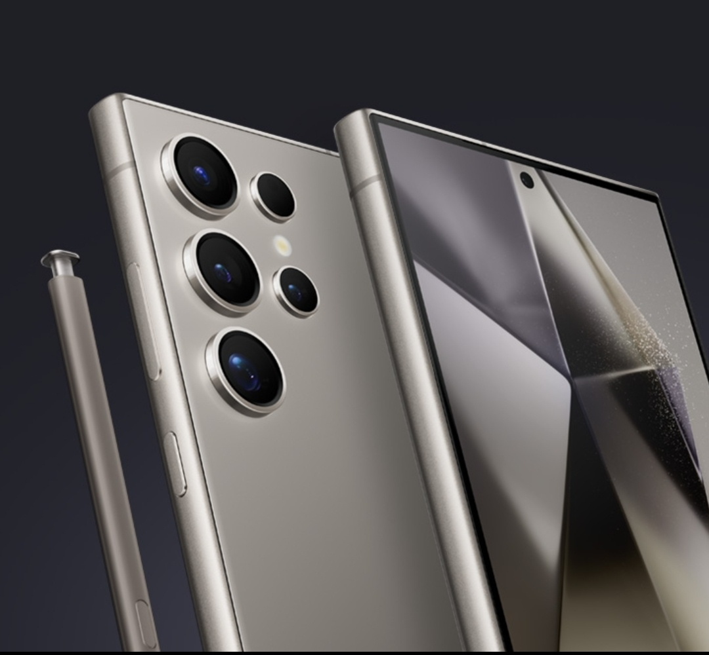
01
Galaxy S24 Ultra

Slide 5
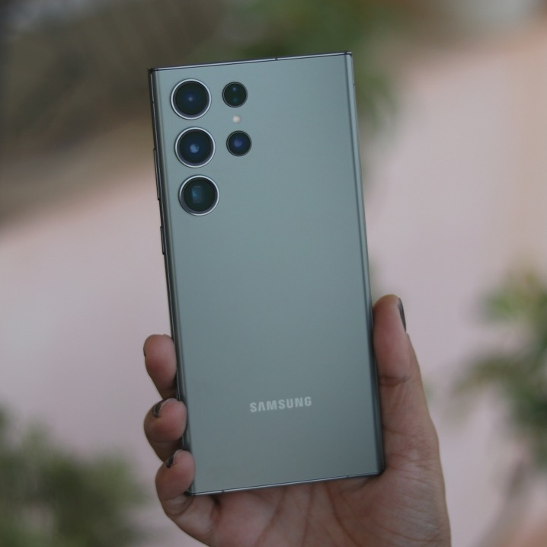
Description
The S24 Ultra : A pinnacle of innovation in smartphone technology.
Sleek design crafted to impress.
Stunning 6.8-inch Dynamic Amoled display for vivid visuals.
Powered by the latest Snapdragon processor for lightning-fast performance.
Quad-camera system with a 108MP main sensor.
Versatile shooting modes for any photography scenario.
8K video recording capabilities for stunning video content.

Slide 6
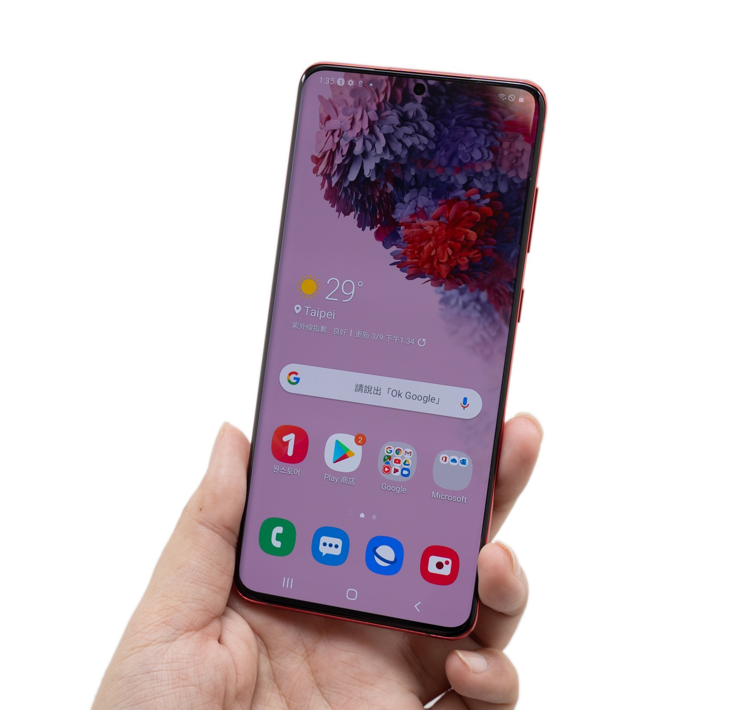
Key Features
Galaxy AI with futuristic experience,more powerful processor and operating system.
Switch from iOS to Android
All-day battery to play on and on
Capture details that rival reality
Brightest mobile with 2600 nit display

Slide 7
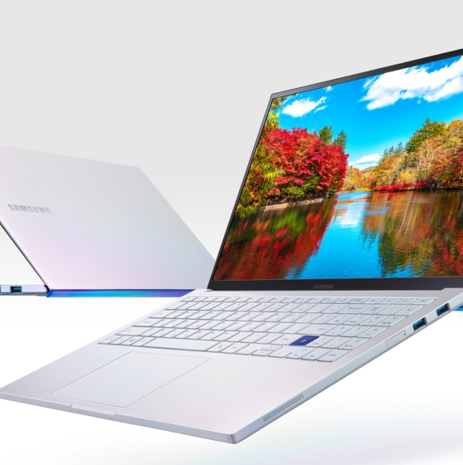
Galaxy Book4 Pro

Slide 8
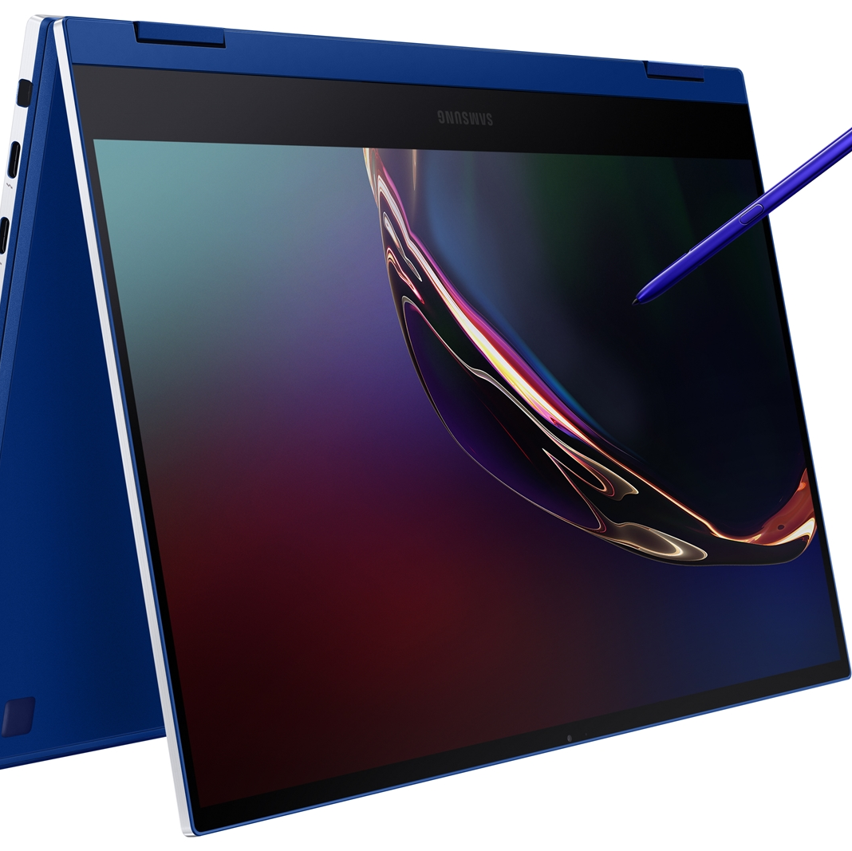
Description
Meet the Galaxy Book4 Pro : A powerhouse of productivity packed into a sleek and portable design.
Boasting a stunning 15.6-inch AMOLED display.
Powered by the latest Intel Core i7 processor and upto 32GB of RAM .
Experience lightning-fast performance for all your tasks.
Up to 1TB of SSD storage .
Array of ports , including USB-C ,HDMI and Thunderbolt.
Long-lasting battery life ,perfect for work or entertainment on the go.

Slide 9
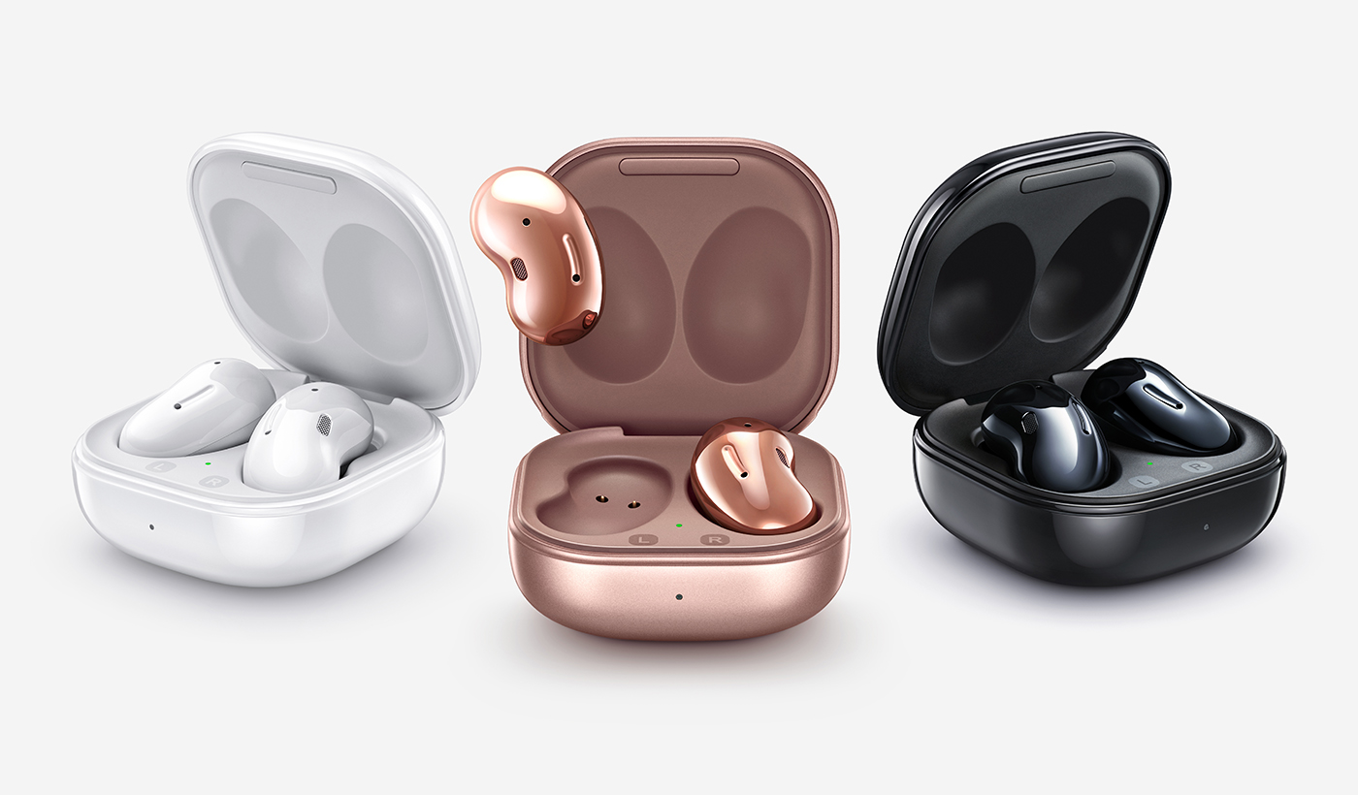
Galaxy Buds2 pro

Slide 10
Description
Galaxy Buds2 Pro : Enjoy conversations in the language you love with Galaxy Buds.
IPX7 Water Resistant against sweat,water and spills.
24-bit Hi-Fi audio .
Intelligent ANC puts your playlist in focus
Voice detect and ambient sound allowing you to clearly hear the conversation.
Fit in your comfort zone with enhanced wind flow which helps reduce ear canal pressure.
With Intelligent 360 Audio which feels more realistic .

Slide 11
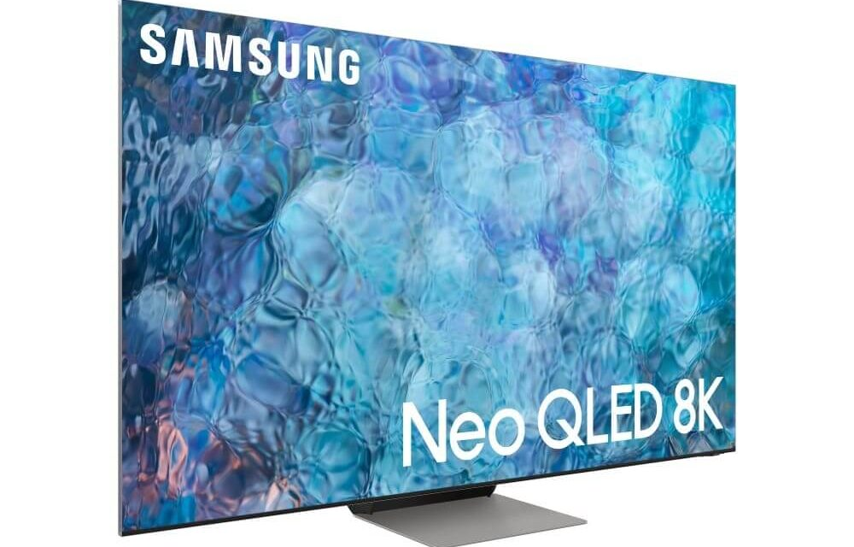
4K Ultra HD Smart Neo QLED TV

Slide 12
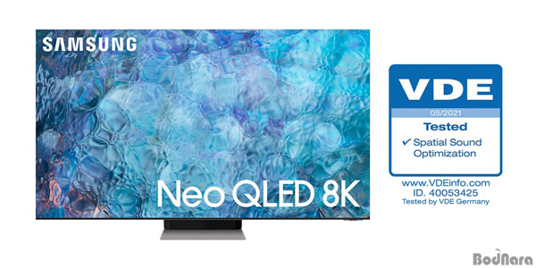
Description
Smart Neo QLED TV : Immerse yourself in stunning visuals and crystal-clear sound like never before.
Sleek design and cutting-edge technology .
Featuring Quantum dot technology with vibrant colors and incredible detail.
Quantum HDR enhances contrast ,delivering deeper blacks and brighter whites.
4K resolution with remarkable clarity and precision.
Al upscaling to transform low resolution content into stunning 4K quality.
Experience true immersion with Object Tracking sound.

Slide 13
02
Determine the platform on which the website is developed (Use online tools to identify)

Slide 14
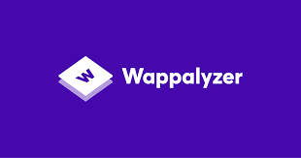
Tool Used

Slide 15
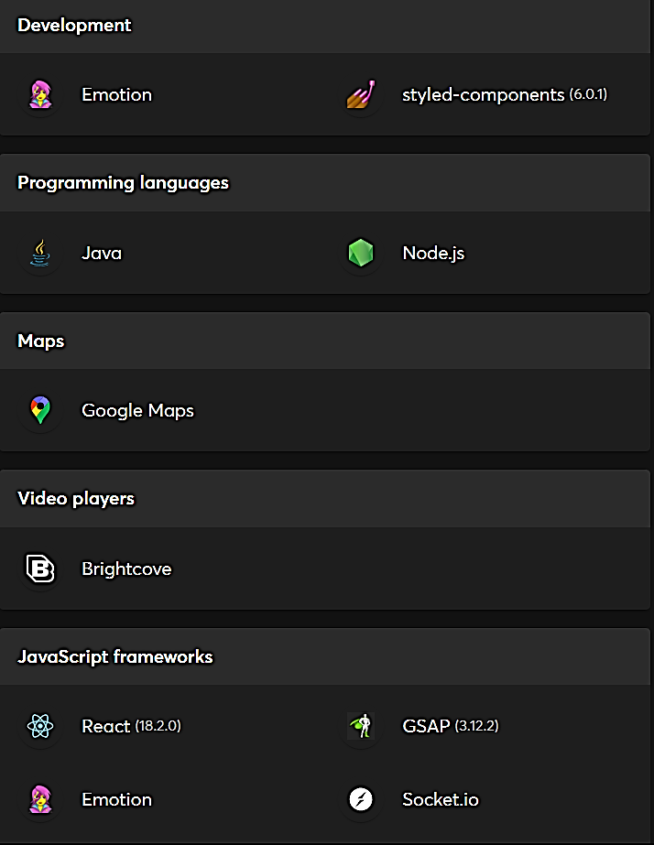
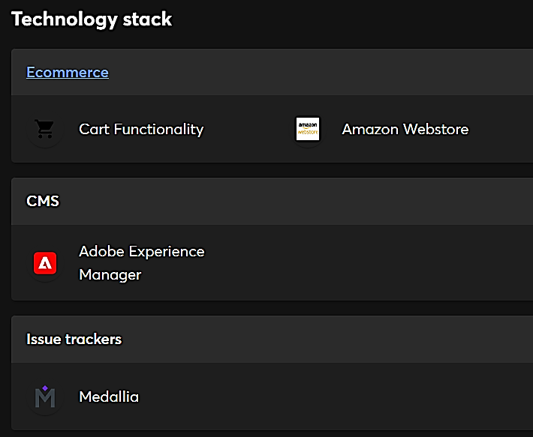
Tools Used
Mercury
Venus
Mercury is the smallest planet of them all
Venus is the second planet from the Sun
Mars is actually a very cold place
Jupiter
Saturn
Neptune
Jupiter is the biggest planet of them all
Saturn is composed of hydrogen and helium
Neptune is very far away from the Sun

Slide 16
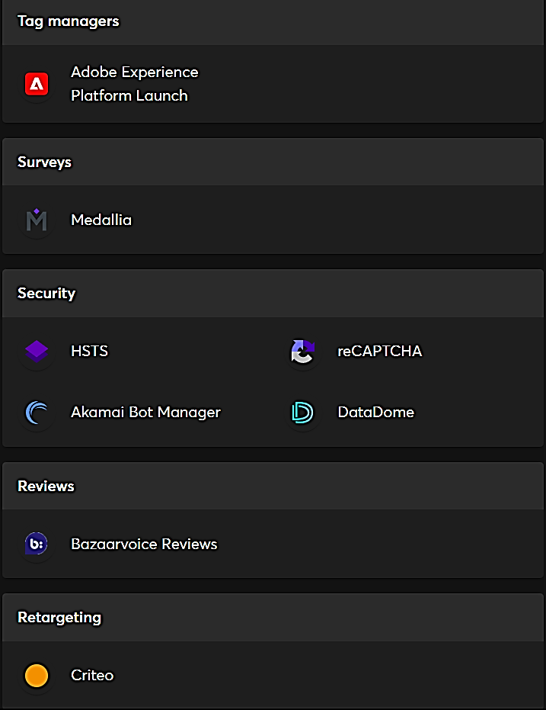
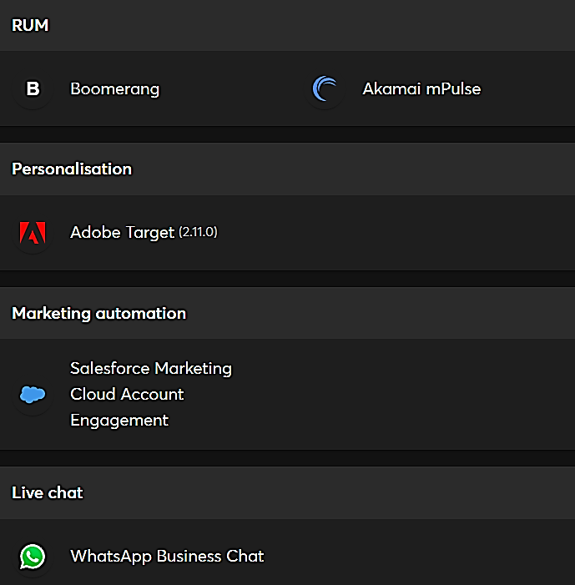

Slide 17
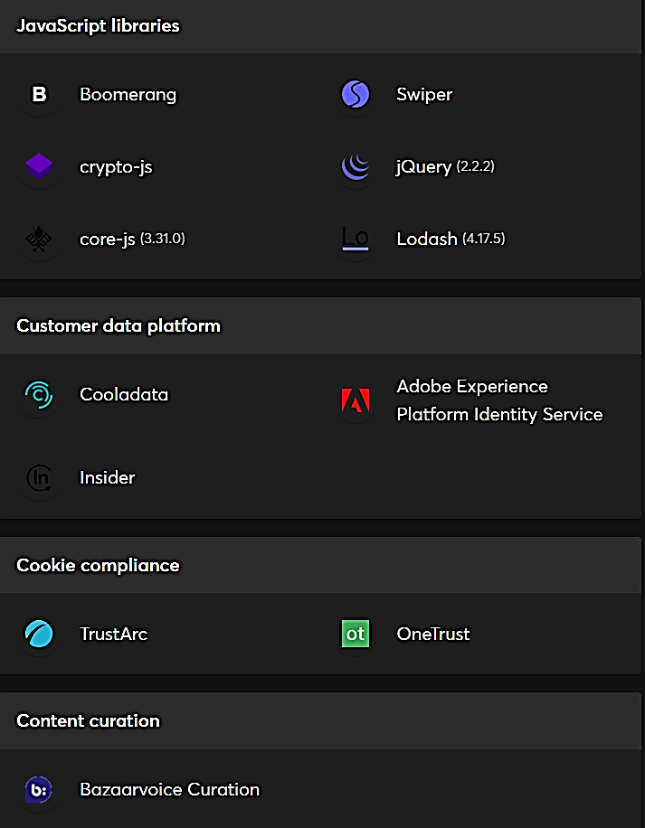
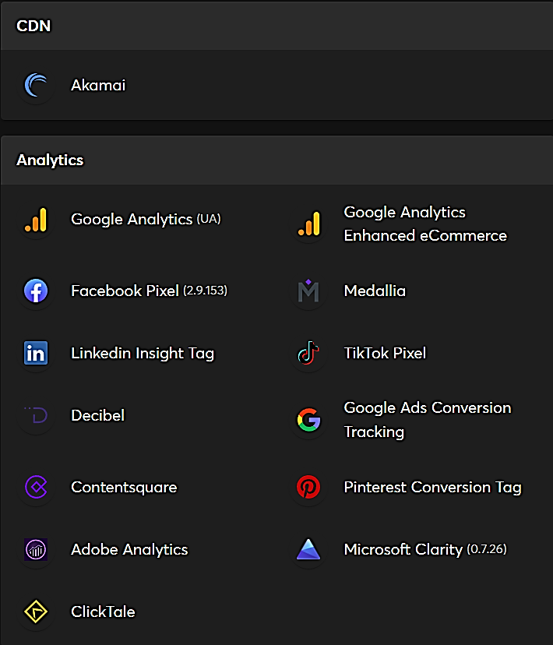

Slide 18
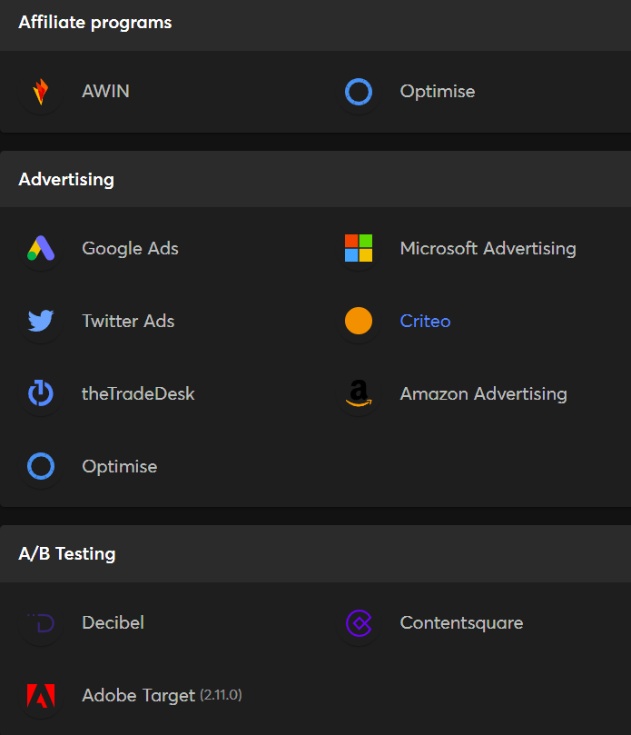
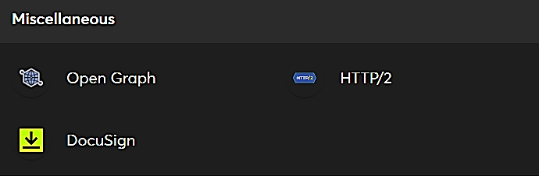

Slide 19
It appears that the website is built using React(18.2.0).The programming language used are Java and Node.js.

Slide 20
03.Test the website’s responsive design and mobile optimization(Share the report).Test a minimum of 5 pages.(Use Online Tools to find)

Slide 21
Tools Used
Google Chrome Dev Tools: It offers a built-in feature that allows you to simulate how your website appears on various devices and screen sizes. Access it by right-clicking on your webpage selecting “Inspect”, then toggling the device toolbar.
Viewport Resizer: Responsive design testing Google chrome extension.

Slide 22


Pages we are going to Test
Responsive
Not Responsive

Slide 23
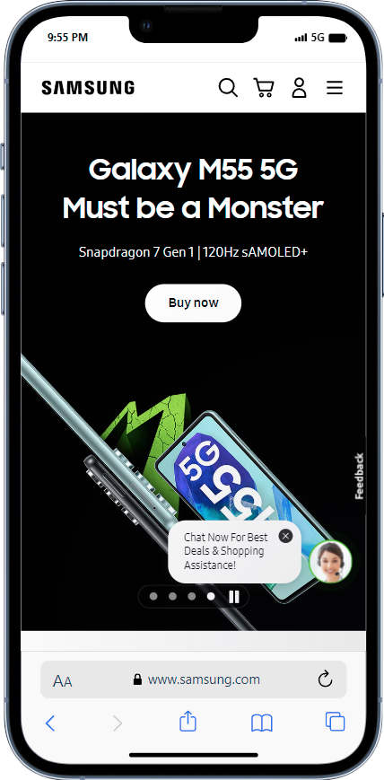

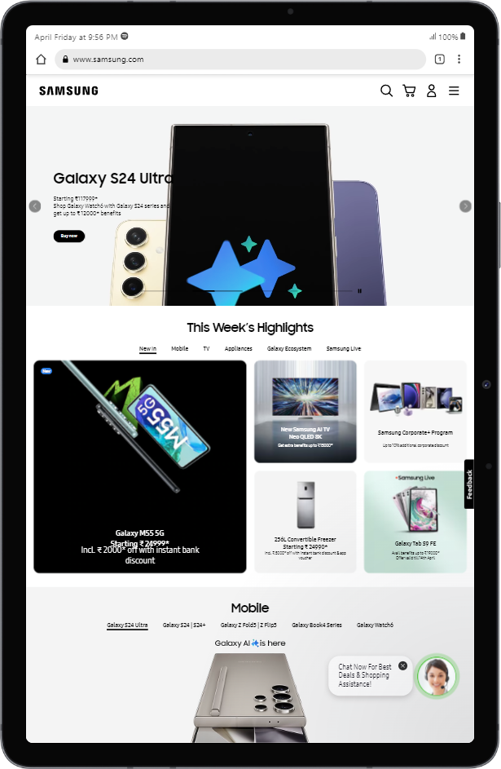
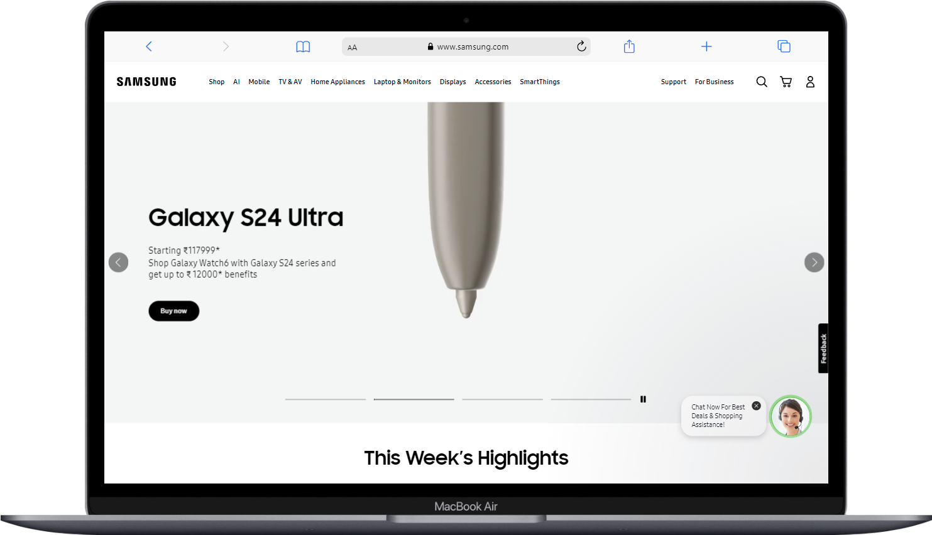
Home Page responsiveness in mobile , ipad and mac book air.

Slide 24
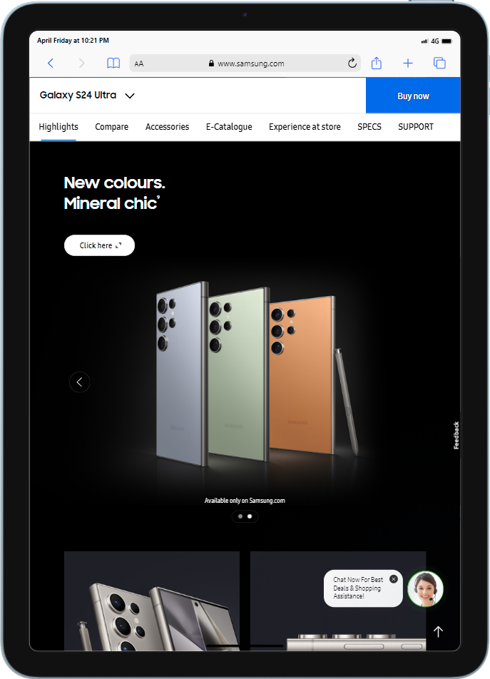
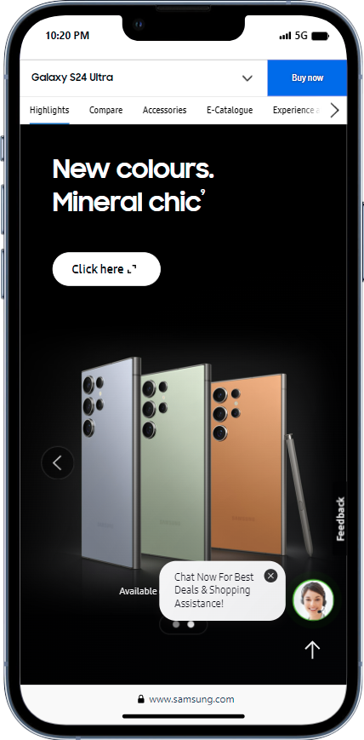
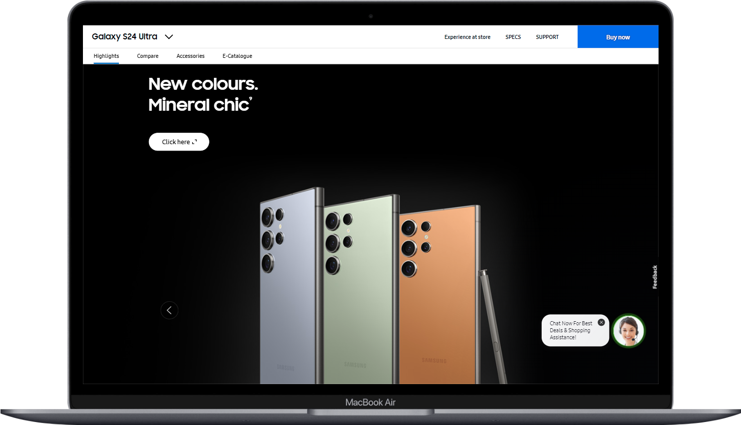
Product Page responsiveness in mobile , ipad and mac book air.

Slide 25
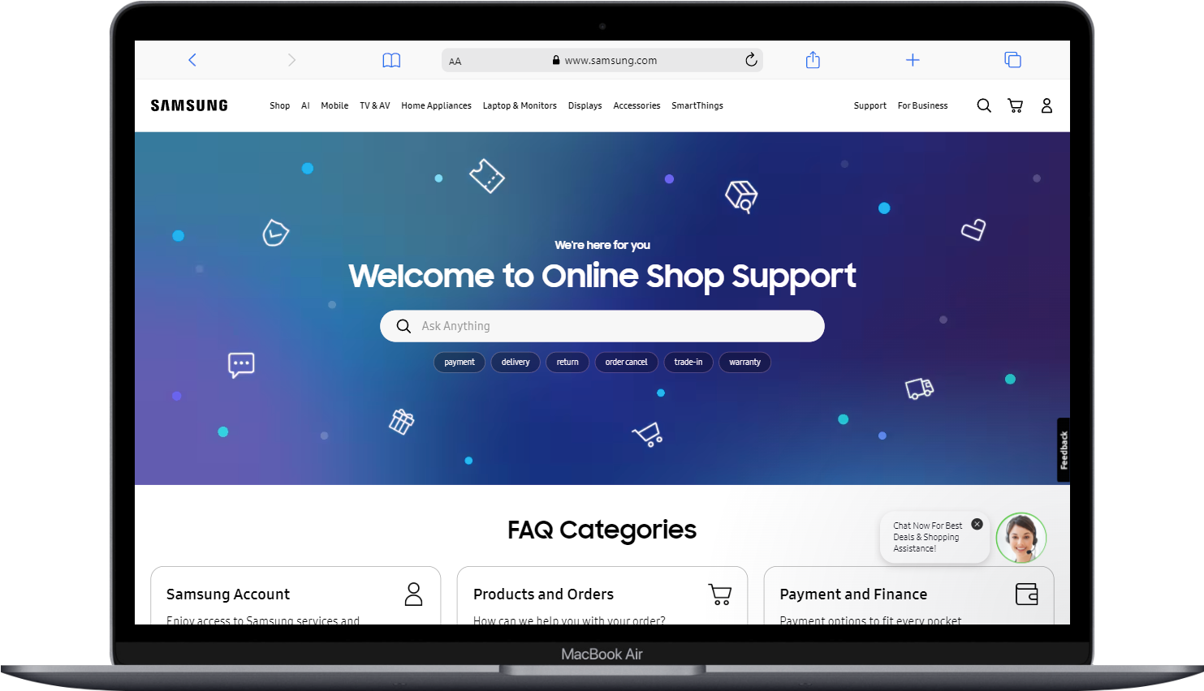
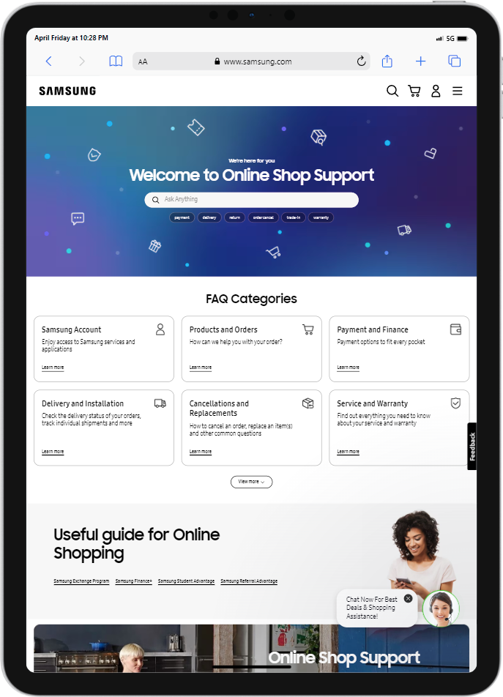
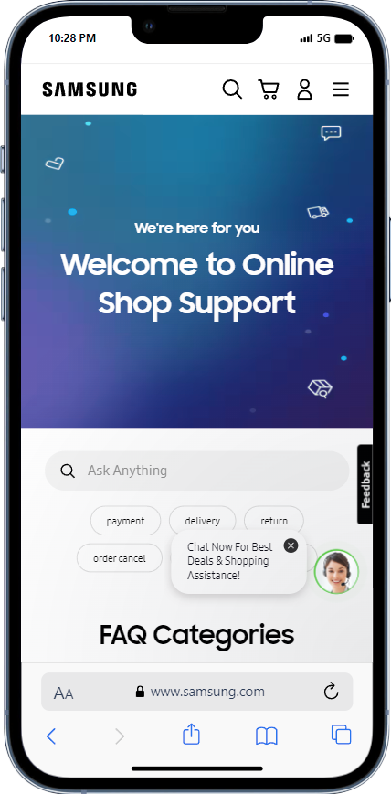
Shopping Help responsiveness in mobile , ipad and mac book air.

Slide 26
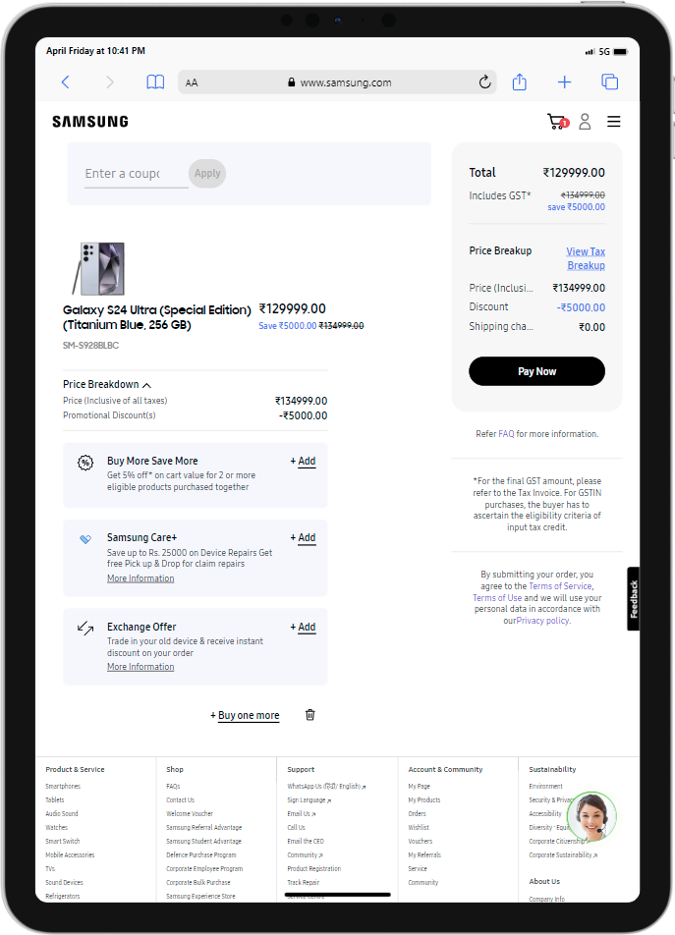
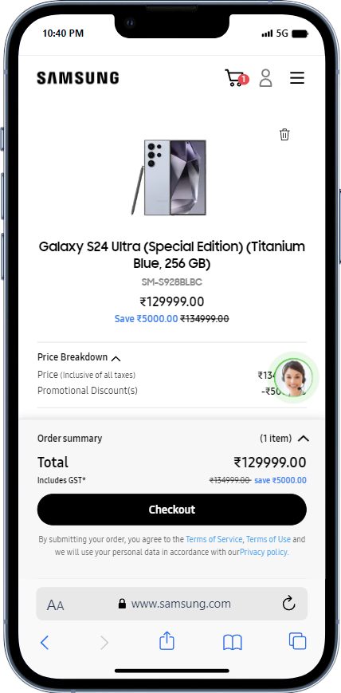
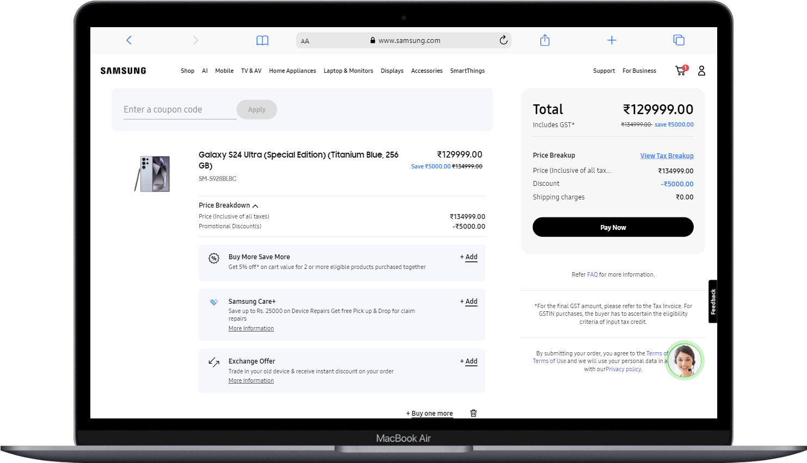
Shopping Cart responsiveness in mobile , ipad and mac book air.

Slide 27
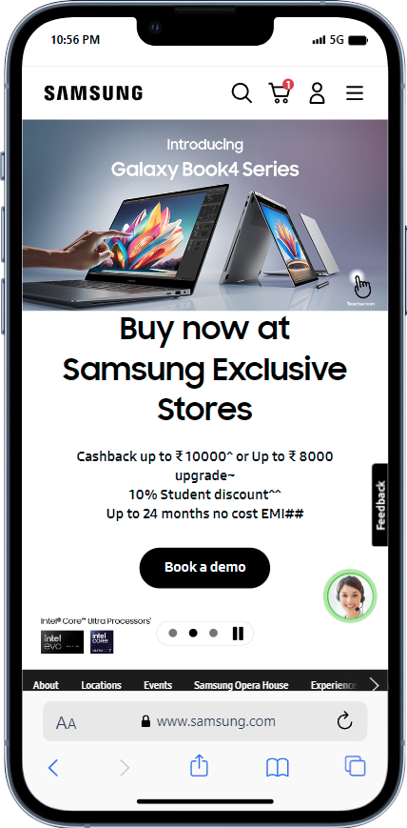
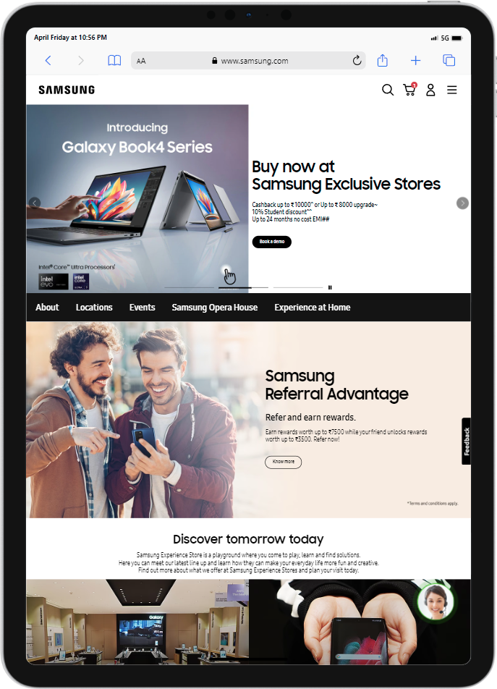
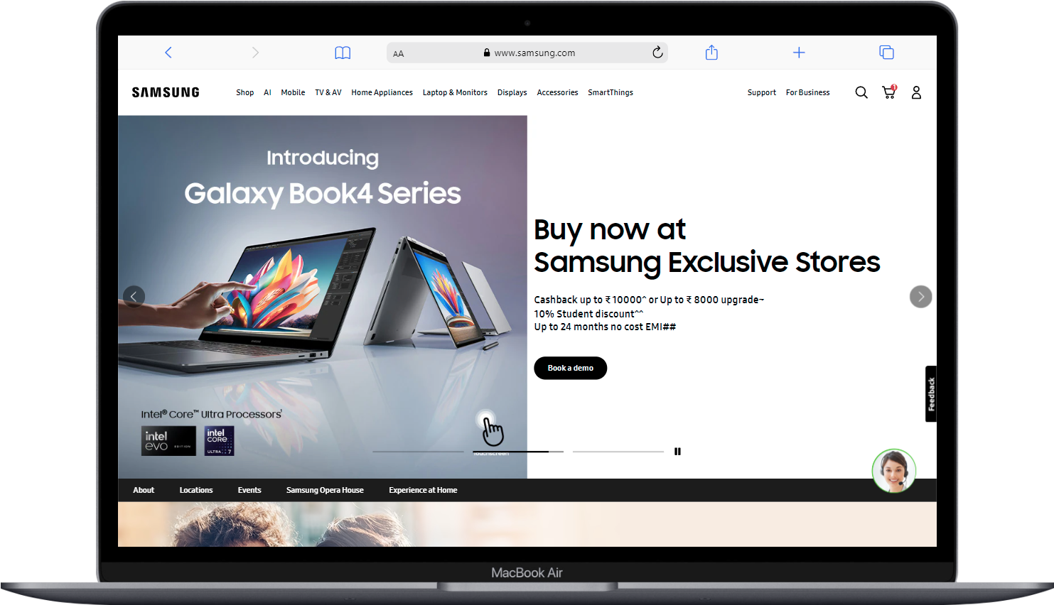
Store Page responsiveness in mobile , ipad and mac book air.

Slide 28
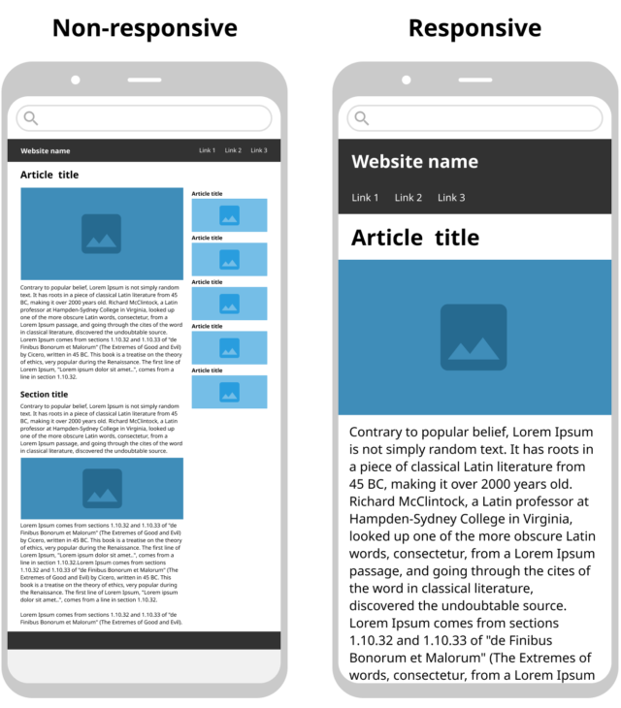
Common mistakes in Website to Avoid
1. Avoiding a Mobile-First Design
The stats indicate how a mobile-first design is critical for online businesses.
Today, most prefer using mobiles or tablets to search for businesses or services online.
As a business owner, one would not like to miss out on such a high conversion intent.
In order to cater to a mobile-friendly global audience, a responsive website that is also mobile optimized is critical.

Slide 29
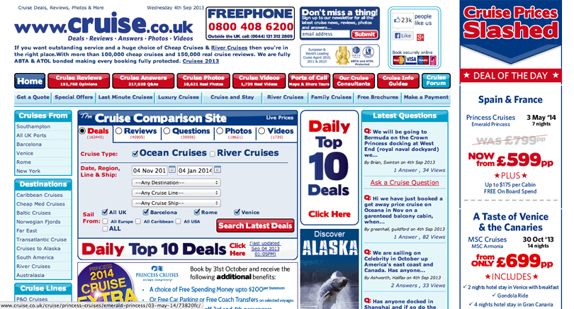
2. Cluttered Site Navigation
A home page web design must be neat, intuitive, and easy to navigate.
Often users come across home pages that offer too many links, making it difficult to find what they need.
Cluttered website navigation is one of the biggest web design mistakes to avoid.
Users are bound to be confused with many items on a single page.
Naturally, users will find it difficult to navigate to the desired page and might bounce.
Additionally, the page is not visually appealing. Such landing pages result in very few conversions and hurt the ROI.

Slide 30
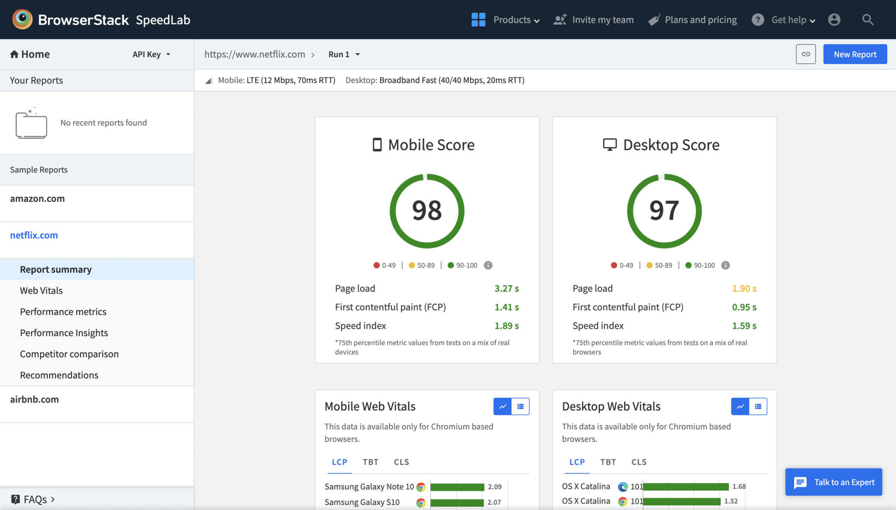
3. Slow Loading Web Pages
Subconsciously, no user likes to wait more than 2-3 seconds
A 1-second delay in page response can result in a 7% reduction in conversions.
A slow-loading website is not only one of the top web design mistakes but also an SEO and CRO blunder.
Google crawls your website slower, hence slowing your online presence on search results.
According to Google Search Central, blocked JavaScript, CSS, unplayable content, mobile-only 404s, and faulty redirects need to be solved ASAP when optimizing your website design.
Increasing website speed is necessary for brands and online businesses looking to leverage their website for any ROI-generating activities.

Slide 31
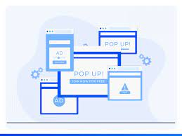
4.Irrelevant Pop-up Implementation
Implement a pop-up to appear only if a user has scrolled down 70% of the web page. (cross-c
Experiment by displaying a floating banner pop-up that makes a user run a trial of your product.
Match the design of the popup with the overall website design or landing page.
Design CTA buttons on the pop-up banner to be clear and actionable.
Choose the right fonts, color contrast, and spacing to streamline your conversion rates.

Slide 32
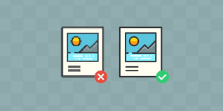
5. Un-optimized Images
Any ideal way to address this issue is to optimize images by compressing them or resizing them.
Use tools like Adobe Photoshop to compress image file sizes significantly, whereas WordPress admins can use plugins like WP Smush for image compression.
It is not enough to check if a website is loading fast on a single browser or versions of one browser.
Testers must ensure that their website images and videos load as intended across multiple browsers – the latest and legacy versions.

Slide 33
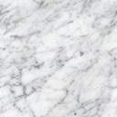
List of best practices for creating visually appealing and user-friendly website designs.

Slide 34
Clear Layout : Organize the components of your website so that users can navigate and access information with ease.
Readable Fonts : Choose simple and relatable fonts to enhance content legibility. Aim for a font size that is comfortable for most users.
High-Quality Images : Include sharp and relevant images that enhance your content. Optimize them for fast loading without compromising quality

Slide 35
Mobile Responsiveness : Design your website to be accessible and functional on various devices, ensuring a seamless experience for both desktop and mobile users .
Readable Fonts : Create a straightforward navigation menu that helps users easily find their way around the site. Use clear labels for menu items.
Consistent Branding : Maintain a consistent design across all pages to reinforce your brand identity .Use the same logo , colors ,typography throughout.

Slide 36
Design a landing page for their product or services to generate leads.

Slide 37
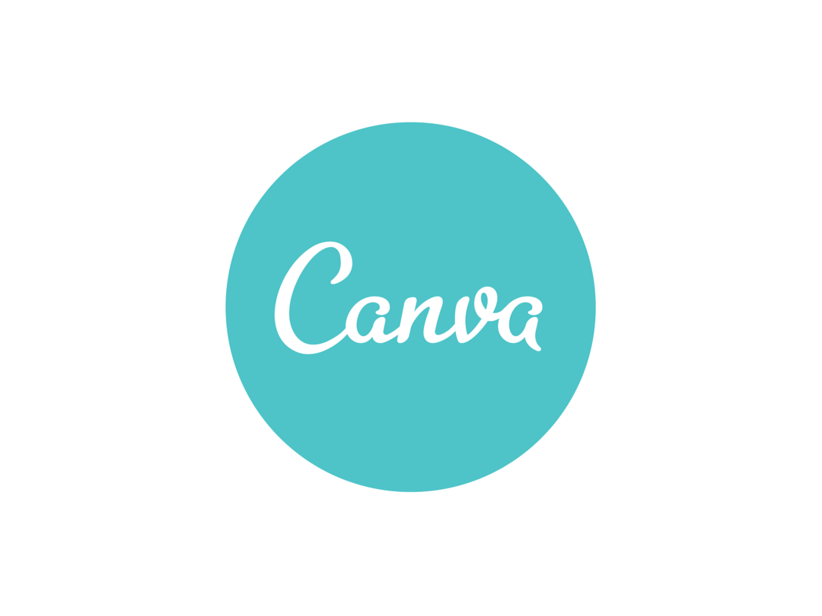
Tool Used to create Landing Page
This Photo by Unknown Author is licensed under CC BY

Slide 38
Take me to the Landing Page

Slide 39
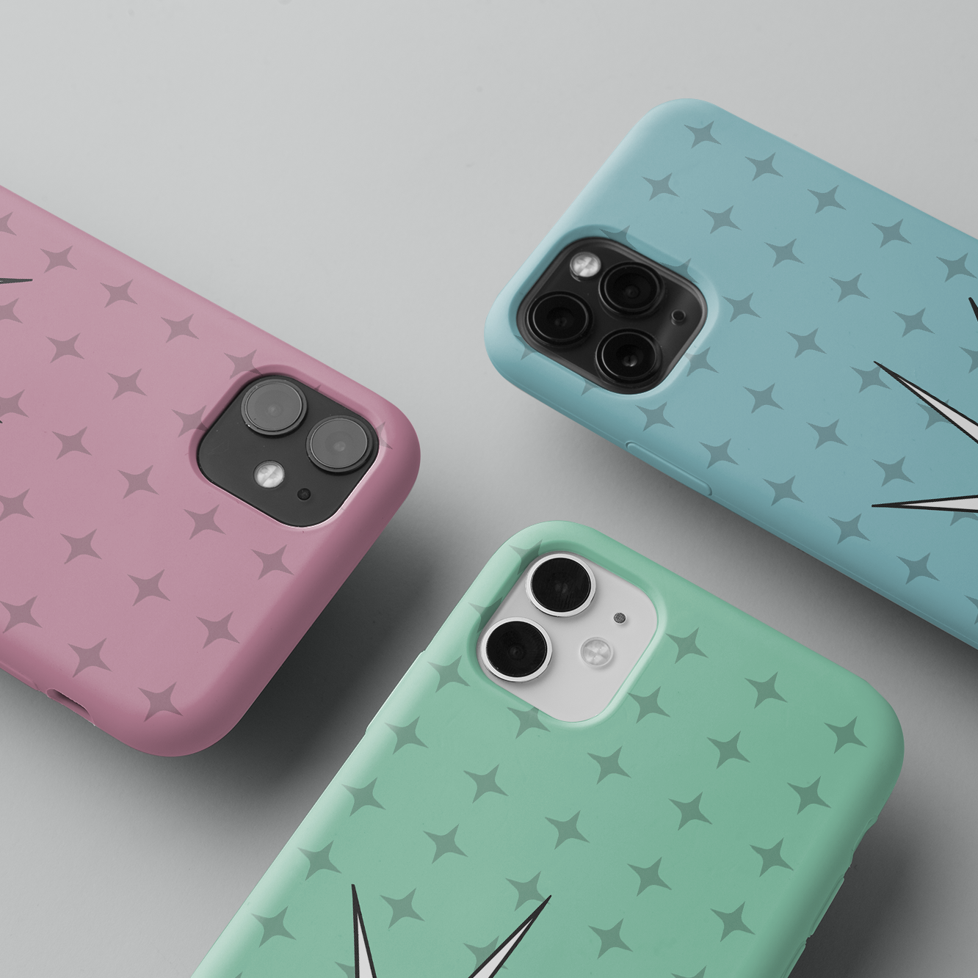
Thank You !

